Slide 1

Plug-in Development Tips and Tricks
“In PDE we do tooling, but our business is people”
Chris Aniszczyk <zx@code9.com>
Principal Consultant at Code 9
PDE Technical Lead
Eclipse Foundation, Inc.
Plug-in Development Tips and Tricks | © 2008 by Chris Aniszczyk; made available under Creative Commons Att. Nc Nd 2.5
Notes:
Note: Mention that this is focused on plug-in development, not building plug-ins

Slide 2


Agenda
Plug-in Development with PDE
Tips and Tricks
Q&A
Eclipse Foundation, Inc.
Plug-in Development Tips and Tricks | © 2008 by Chris Aniszczyk; made available under Creative Commons Att. Nc Nd 2.5

Slide 3
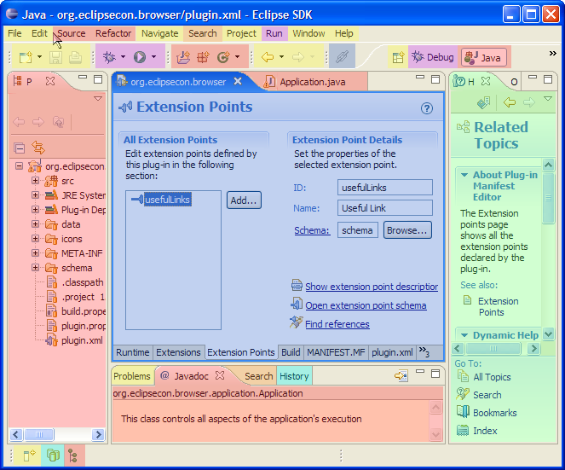
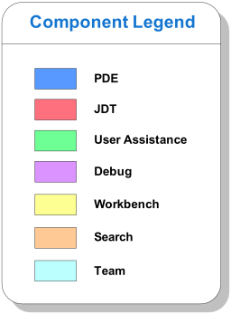
Seamless Integration of Components
Eclipse Foundation, Inc.
Plug-in Development Tips and Tricks | © 2008 by Chris Aniszczyk; made available under Creative Commons Att. Nc Nd 2.5

Slide 4
PDE
PDE = Plug-in Development Environment
Tools to develop Eclipse plug-ins
  Wizards to create, import and export plug-ins and features
  Specialized editors for plug-in manifest files
  Templates for new plug-ins
  Launchers to run, debug and test plug-ins
  NLS tools to internationalize plug-ins
  Automated class path management
Eclipse Foundation, Inc.
Plug-in Development Tips and Tricks | © 2008 by Chris Aniszczyk; made available under Creative Commons Att. Nc Nd 2.5

Slide 5
PDE Details
PDE is implemented as a set of plug-ins
PDE is built on top of the Eclipse Platform and JDT
  Uses Eclipse Platform and JDT extension points and APIs
PDE is seamlessly integrated into Eclipse
PDE gets no special treatment from the Platform or JDT
Eclipse Foundation, Inc.
Plug-in Development Tips and Tricks | © 2008 by Chris Aniszczyk; made available under Creative Commons Att. Nc Nd 2.5

Slide 6
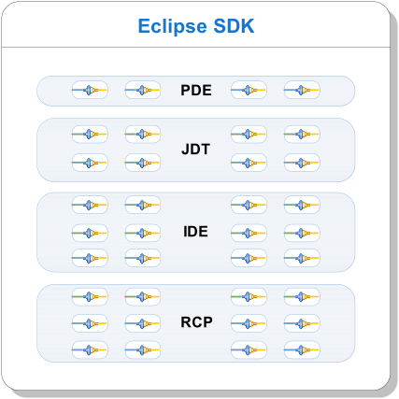
Plug-ins All the Way Down
A plug-in is the fundamental building block of an Eclipse product
Plug-ins build on top of and use other plug-ins
To extend Eclipse, you must write plug-ins
To write a rich client application, you must write plug-ins
To write an OSGi-based application, you must write plug-ins (bundles)
Eclipse Foundation, Inc.
Plug-in Development Tips and Tricks | © 2008 by Chris Aniszczyk; made available under Creative Commons Att. Nc Nd 2.5

Slide 7

Agenda
Plug-in Development with PDE
Tips and Tricks
Q&A
Eclipse Foundation, Inc.
Plug-in Development Tips and Tricks | © 2008 by Chris Aniszczyk; made available under Creative Commons Att. Nc Nd 2.5

Slide 8
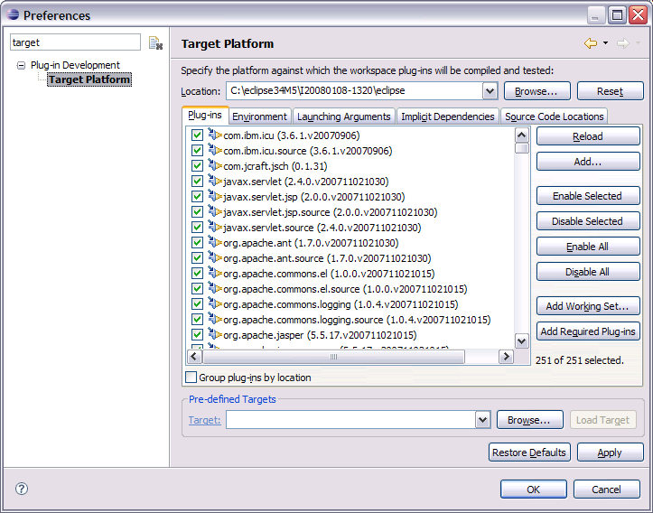
Target Management
Helps you to specify plug-in in which to build and run with.
Includes tabs to set environment values, launching arguments, implicit dependencies, and source code locations.
You can add plug-ins to the current target platform by using target provisioners. Current provisioners allow you to specify locations on your file system and the locations of update sites.
The plug-ins can be viewed as a list or a tree (separated by locations).
Eclipse Foundation, Inc.
Plug-in Development Tips and Tricks | © 2008 by Chris Aniszczyk; made available under Creative Commons Att. Nc Nd 2.5

Slide 9
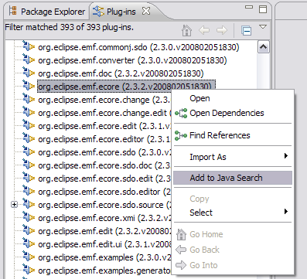
Plug-ins View
A view into all the plug-ins you’re working with
Has the ability to add things to java search which can help you find classes via Ctrl+Shift+T
Eclipse Foundation, Inc.
Plug-in Development Tips and Tricks | © 2008 by Chris Aniszczyk; made available under Creative Commons Att. Nc Nd 2.5

Slide 10
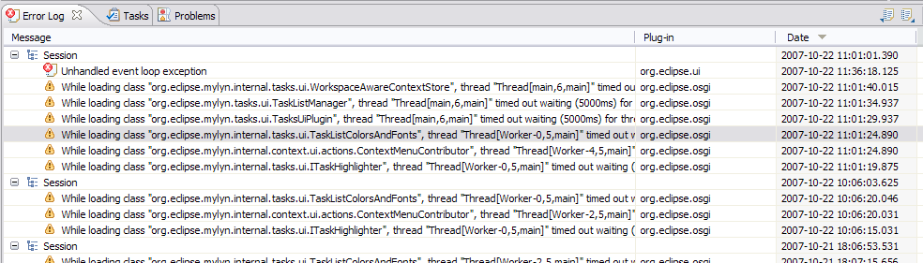
Error Log
More than meets the eye…
Group log entries by
  Session
  Plug-in
Eclipse Foundation, Inc.
Plug-in Development Tips and Tricks | © 2008 by Chris Aniszczyk; made available under Creative Commons Att. Nc Nd 2.5

Slide 11
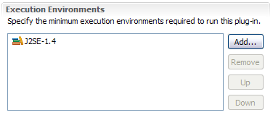
Execution Environments
Execution Environments are symbolic representations of JREs
Bundle-RequiredExecutionEnvironment (BREE) manifest header
PDE Build uses BREE to determine compile settings
http://wiki.eclipse.org/Execution_Environments
Eclipse Foundation, Inc.
Plug-in Development Tips and Tricks | © 2008 by Chris Aniszczyk; made available under Creative Commons Att. Nc Nd 2.5

Slide 12
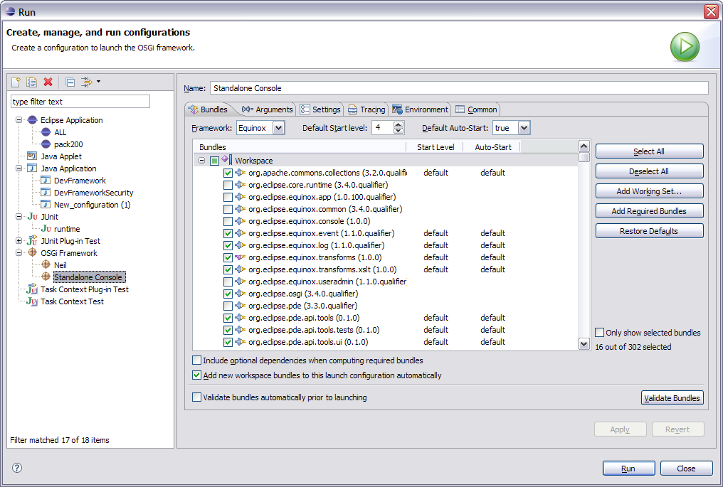
OSGi Launch Configurations
Provides a way to easily run and test your bundle in an OSGi environment.
Extensible framework that allows other OSGi runtimes to provide implementations to let users test on runtimes other than Equinox
Gives users more advanced control, including the option to specify start levels for individual bundles.
Eclipse Foundation, Inc.
Plug-in Development Tips and Tricks | © 2008 by Chris Aniszczyk; made available under Creative Commons Att. Nc Nd 2.5

Slide 13
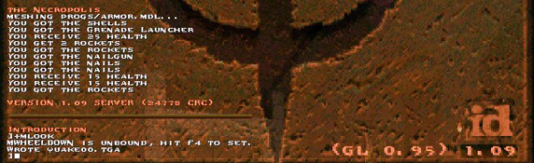
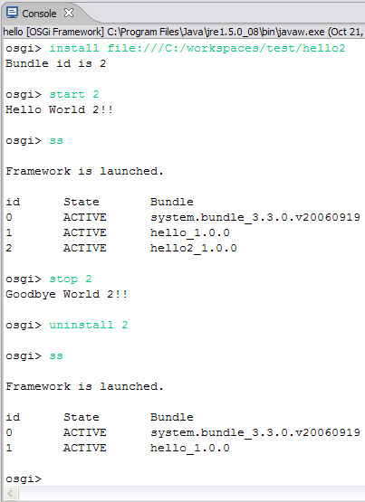
OSGi Console
-console
Integrate with the console that drives Eclipse
Common commands
  Status
  Start/stop
  Install/uninstall
  diag
Custom Commands
http://www-128.ibm.com/developerworks/opensource/library/os-ecl-osgiconsole/
Eclipse Foundation, Inc.
Plug-in Development Tips and Tricks | © 2008 by Chris Aniszczyk; made available under Creative Commons Att. Nc Nd 2.5

Slide 14
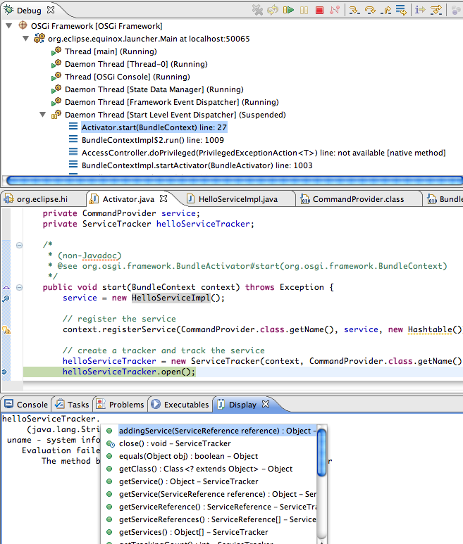
Display View
The Display View allows you to execute/inspect code while you are stopped at a break point. This can be very helpful when trying to find specific objects or debug their contents.
Eclipse Foundation, Inc.
Plug-in Development Tips and Tricks | © 2008 by Chris Aniszczyk; made available under Creative Commons Att. Nc Nd 2.5

Slide 15
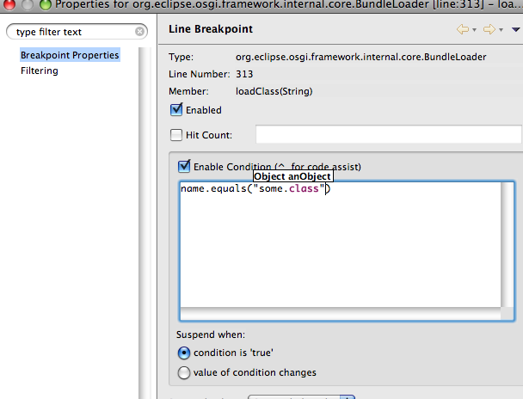
Conditional Breakpoints
You can enable any breakpoint to stop only when it meets certain criteria. This helps if you are trying to iterate through a collection or if you are debugging a function which is called multiple times.
Eclipse Foundation, Inc.
Plug-in Development Tips and Tricks | © 2008 by Chris Aniszczyk; made available under Creative Commons Att. Nc Nd 2.5

Slide 16
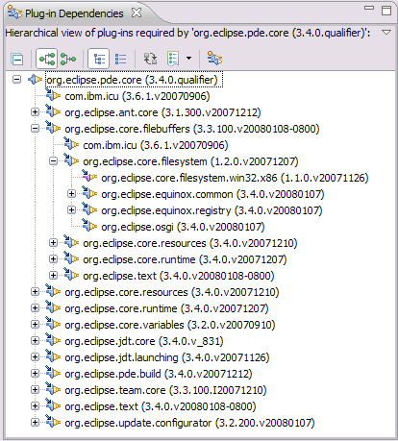
Plug-in Dependencies View
The Plug-in Dependencies view allows you to see all the dependencies for any plug-in project.
You not only see what plug-ins a project depends on, but also what plug-ins depend on that project (callers and callees).
It also can display the current state, including dependency wiring, of the plug-ins in the workspace and target platform. This will aid in finding resolution problems.
Eclipse Foundation, Inc.
Plug-in Development Tips and Tricks | © 2008 by Chris Aniszczyk; made available under Creative Commons Att. Nc Nd 2.5

Slide 17
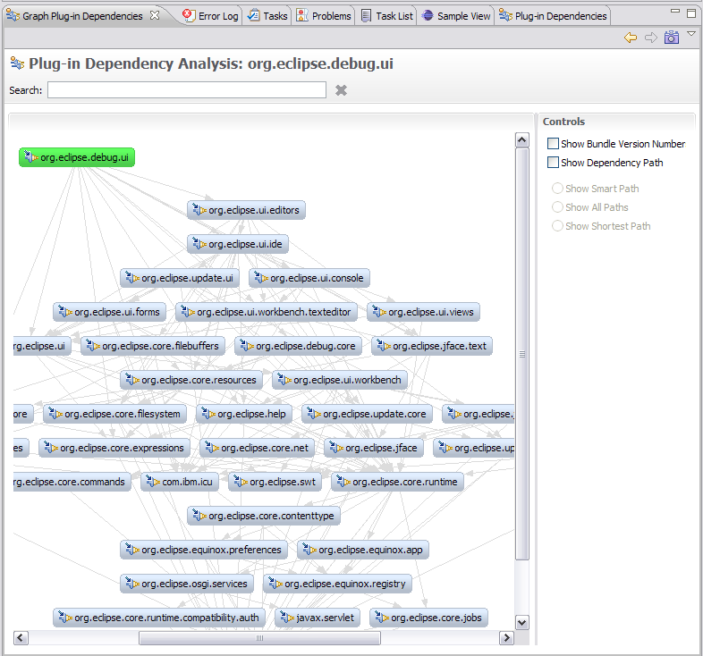
Graph Plug-in Dependencies View
PDE Incubator Project
Visualize your dependencies
Pictures are worth a thousand words
* http://www.eclipse.org/pde/incubator/dependency-visualization/
Eclipse Foundation, Inc.
Plug-in Development Tips and Tricks | © 2008 by Chris Aniszczyk; made available under Creative Commons Att. Nc Nd 2.5

Slide 18
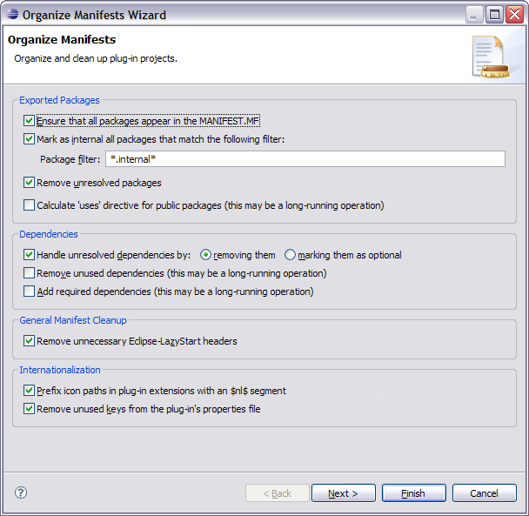
Organize Manifests Wizard
Helps you modify and format your MANIFEST.MFs
Accessible by right clicking on a MANIFEST.MF and selecting PDE Tools > Organize Manifest
Helps you:
  Export all packages in a project
  Remove unresolved packages
  Mark exported packages as internal
  Modify unresolved dependencies (removing or making them optional)
  Remove unused dependencies
  Calculate dependencies (using Dependency Management)
  Prefix icon paths with $nl$
  Remove unused NLS keys
  Calculate ‘uses’ directives
Eclipse Foundation, Inc.
Plug-in Development Tips and Tricks | © 2008 by Chris Aniszczyk; made available under Creative Commons Att. Nc Nd 2.5

Slide 19
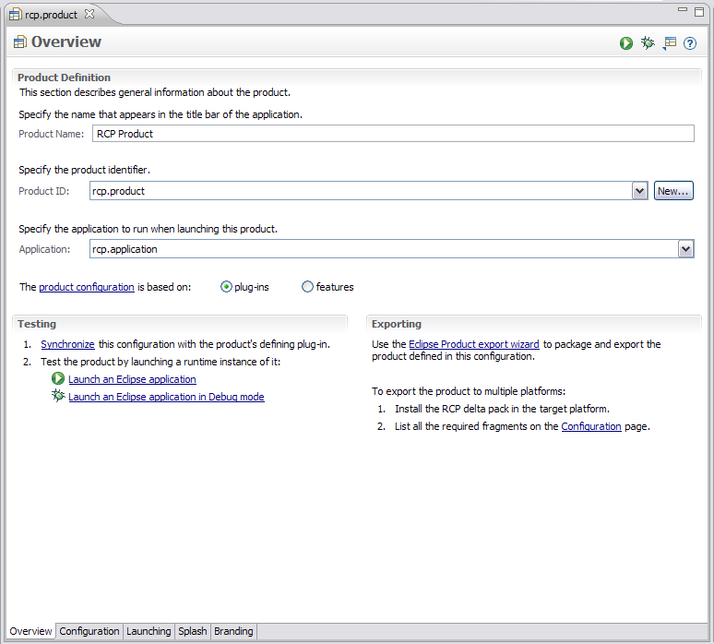
Product Editor
A product definition helps you to easily customize, test and export an RCP/Eclipse application
Customizations include:
  Modifying which plug-ins are included
  Create a splash screen
  Bundling a JVM
  Name for the launcher executable
  Specify program and launching arguments
  Define a welcome page and About dialog
Eclipse Foundation, Inc.
Plug-in Development Tips and Tricks | © 2008 by Chris Aniszczyk; made available under Creative Commons Att. Nc Nd 2.5

Slide 20
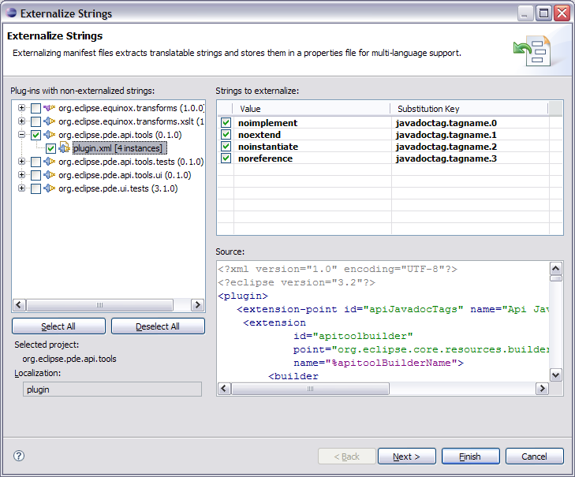
Externalization Strings Wizard
PDE’s Externalize Strings wizard allows you to quickly locate and painlessly externalize values in a plug-in’s MANIFEST.MF and plugin.xml.
Accessible by right clicking on a MANIFEST.MF or plugin.xml and selecting PDE Tools > Externalize Strings…
Externalized values are put in a file specified by the Bundle-Localization header. The default value for this file is “plugin.properties
Eclipse Foundation, Inc.
Plug-in Development Tips and Tricks | © 2008 by Chris Aniszczyk; made available under Creative Commons Att. Nc Nd 2.5

Slide 21
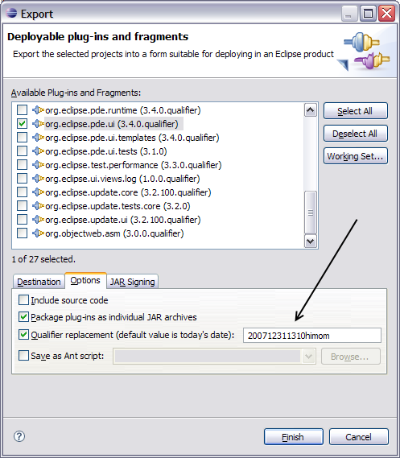
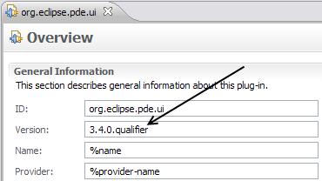
.qualifier is awesome
The “.qualifier” marker allows you to easily substitute a value for the micro segment of a plug-in or feature’s version.
The date is the default value, but you substitute any value when exporting your project using the PDE export wizards.
Eclipse Foundation, Inc.
Plug-in Development Tips and Tricks | © 2008 by Chris Aniszczyk; made available under Creative Commons Att. Nc Nd 2.5

Slide 22
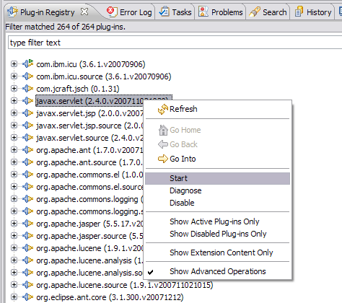
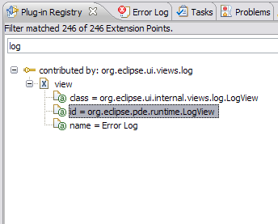
Plug-in Registry View
The Plug-in Registry view is your eye into the runtime
Show Advanced Operations
  start/stop bundles
Show Extension Content Only
  quickly browse extensions
Eclipse Foundation, Inc.
Plug-in Development Tips and Tricks | © 2008 by Chris Aniszczyk; made available under Creative Commons Att. Nc Nd 2.5

Slide 23
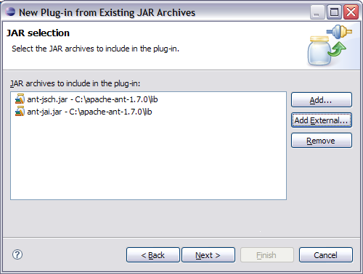
Plug-in Project from existing jars
The Plug-in Project from Existing Jars wizard enables you to quickly convert jar files to plug-ins.
Helpful when an application is being converted to OSGi and it depends on certain library jars
Can be very useful for utility jars, as they can be shared across multiple plug-ins instead of requiring the jars be included in each plug-in
Embedded JARs are evil
Eclipse Foundation, Inc.
Plug-in Development Tips and Tricks | © 2008 by Chris Aniszczyk; made available under Creative Commons Att. Nc Nd 2.5

Slide 24
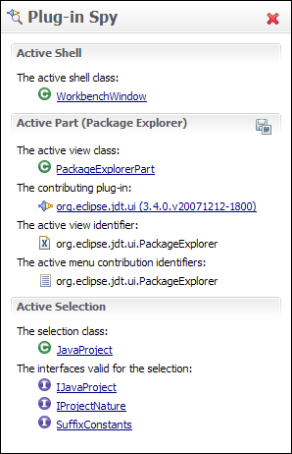
Plug-in Spy (3.4M3)
ALT+SHIFT+F1
Allows you to introspect what you’re looking at…
Hyperlinking
Shows contributing plug-ins
Eclipse Foundation, Inc.
Plug-in Development Tips and Tricks | © 2008 by Chris Aniszczyk; made available under Creative Commons Att. Nc Nd 2.5

Slide 25
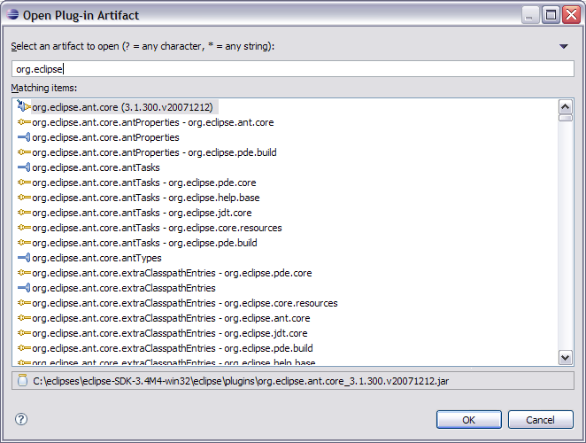
Open Plug-in Artifact (3.4M4)
Ctrl+Shift+A
Quickly browse plug-ins, extensions and extension points
Eclipse Foundation, Inc.
Plug-in Development Tips and Tricks | © 2008 by Chris Aniszczyk; made available under Creative Commons Att. Nc Nd 2.5

Slide 26
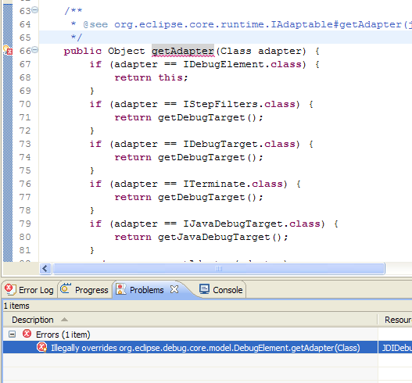
API Tooling (3.4M6)
API tooling will assist developers in API maintenance by reporting…
  API defects such as binary incompatibilities
  incorrect plug-in version numbers
  missing or incorrect @since tags
  usage of non-API code between plug-ins
Eclipse Foundation, Inc.
Plug-in Development Tips and Tricks | © 2008 by Chris Aniszczyk; made available under Creative Commons Att. Nc Nd 2.5

Slide 27
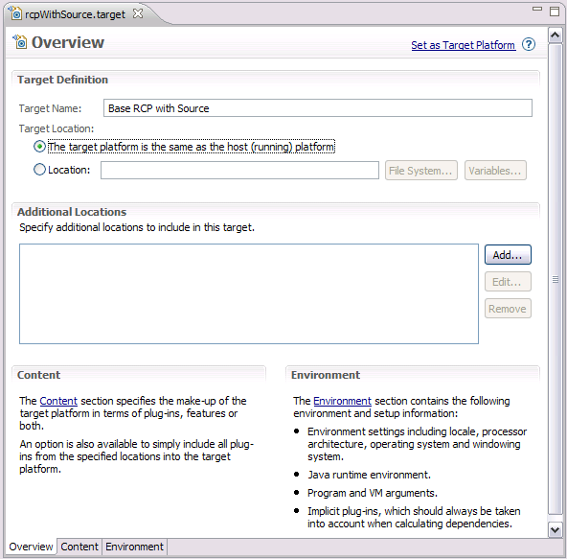
Target Editor
A target definition if a file that helps to configure your PDE development environment.
They can be created in the workspace or loaded from plug-ins who define them in your platform.
Eclipse Foundation, Inc.
Plug-in Development Tips and Tricks | © 2008 by Chris Aniszczyk; made available under Creative Commons Att. Nc Nd 2.5
Notes:
Includes the ability to set:
the target platform location and additional directories
The target environment
The default JRE
Default vm and program arguments
Implicit plug-ins

Slide 28
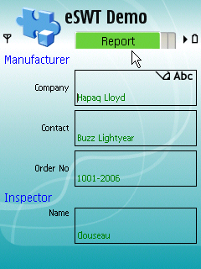
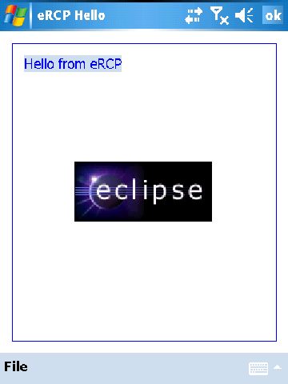
Embedded Rich Client Platform (RCP)
embedded Rich Client Platform: RCP meets device!
Eclipse Foundation, Inc.
Plug-in Development Tips and Tricks | © 2008 by Chris Aniszczyk; made available under Creative Commons Att. Nc Nd 2.5

Slide 29
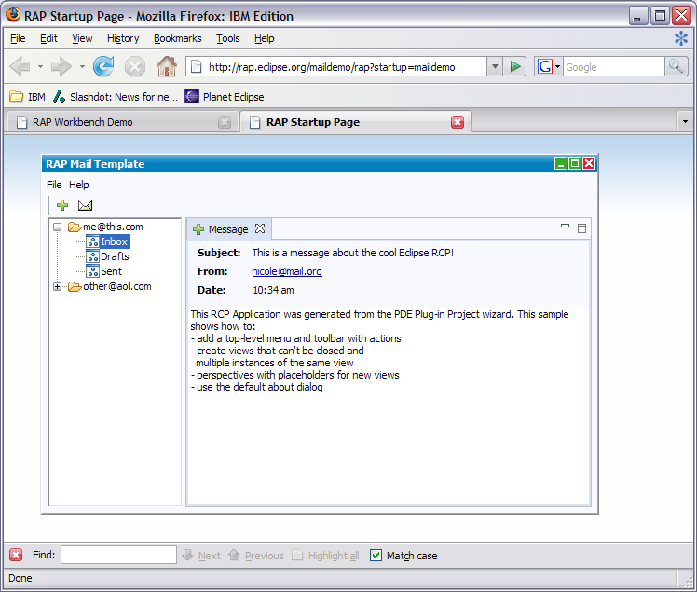
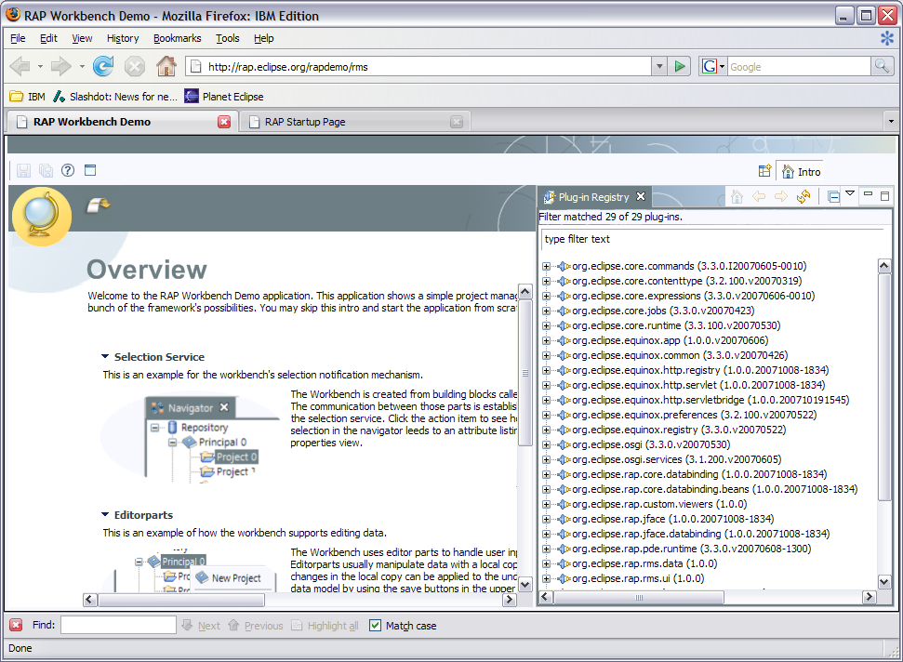
Rich Ajax Platform (RAP)
Rich Ajax Platform (RAP): RCP meets the Web!
Eclipse Foundation, Inc.
Plug-in Development Tips and Tricks | © 2008 by Chris Aniszczyk; made available under Creative Commons Att. Nc Nd 2.5

Slide 30

Agenda
Plug-in Development with PDE
Tips and Tricks
Q&A
Eclipse Foundation, Inc.
Plug-in Development Tips and Tricks | © 2008 by Chris Aniszczyk; made available under Creative Commons Att. Nc Nd 2.5

Slide 31

Conclusion
http://www.eclipse.org/pde
Want to contribute?
  PDE Bug Day
  http://wiki.eclipse.org/BugDay
Thank you!
Eclipse Foundation, Inc.
Plug-in Development Tips and Tricks | © 2008 by Chris Aniszczyk; made available under Creative Commons Att. Nc Nd 2.5

Slide 32
Questions?
Eclipse Foundation, Inc.
Plug-in Development Tips and Tricks | © 2008 by Chris Aniszczyk; made available under Creative Commons Att. Nc Nd 2.5

